Slide 1
Chicago Crime

Slide 2
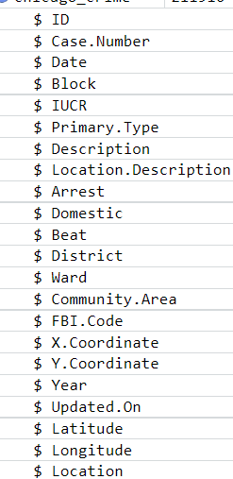
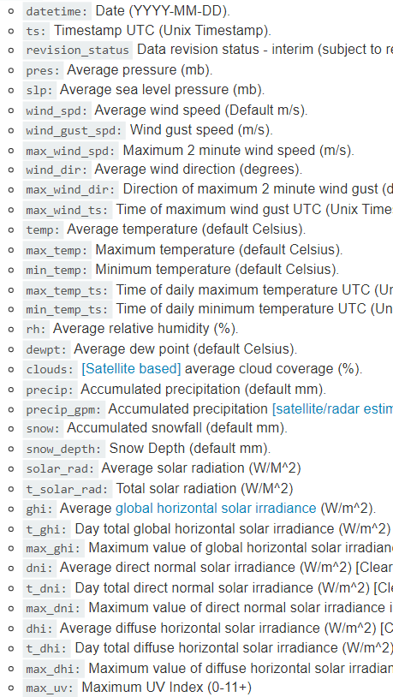
Datasets
Crime in Chicago in 2020
Source: City of Chicago
22 original variables
Weather API
Source: Weatherbit | Global Weather Data Service
35 original variables

Slide 3
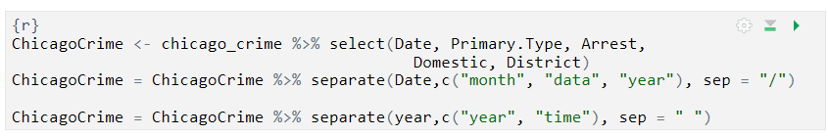
Preliminary Data Cleaning

Slide 4
1.
How does weather affect assault crimes in Chicago?
Analyzing how weather conditions impact the frequency of assault crimes

Slide 5
Code
used weather API
combined Chicago weather data from API with original Chicago crime CSV

Slide 6
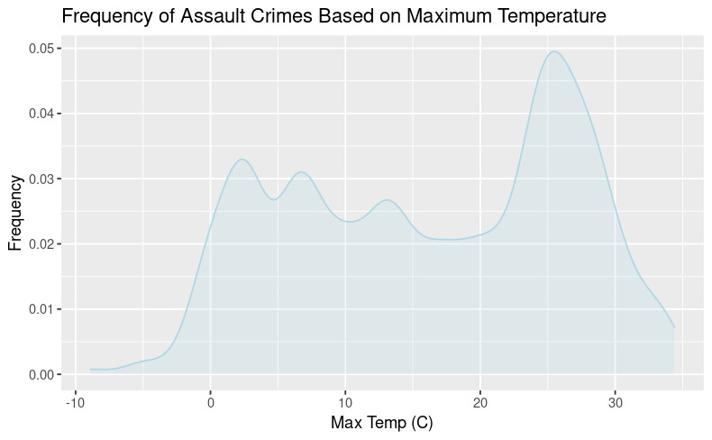

Slide 7
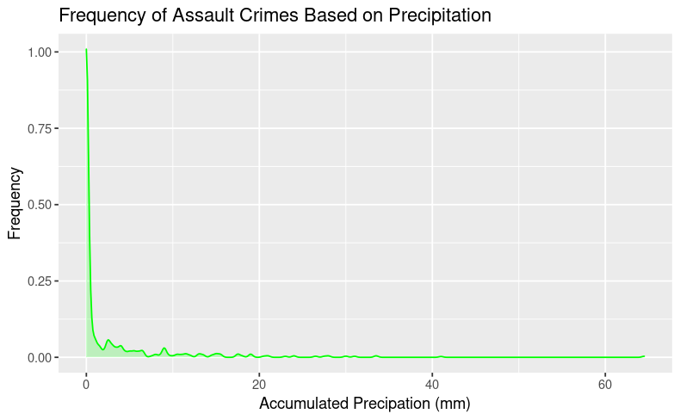

Slide 8

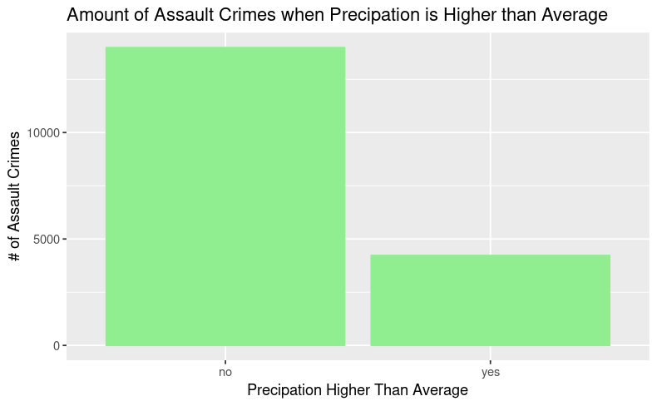

Slide 9
2.
What times of the year do most assaults take place and how does this compare to other crimes such as theft and homicide?

Slide 10
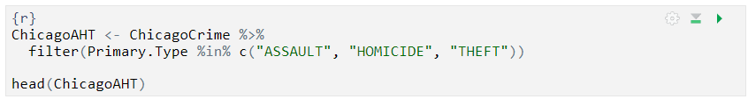
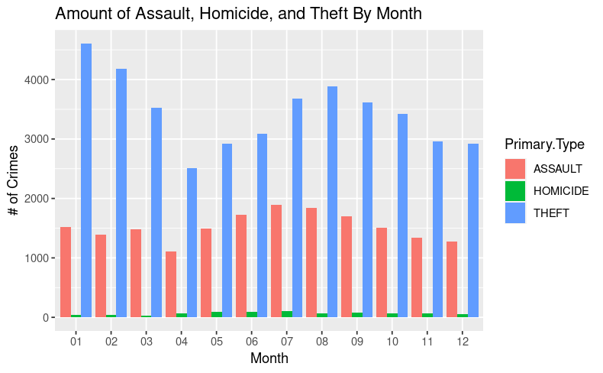
Code and Graphics
Theft peaks in January
Homicide and assault peak in the summer months
Covid-19 considerations

Slide 11
3.
How do assault crimes in Chicago vary based on location?
Analyzing what community areas see the most assault crimes and visualizing locations of crimes using an interactive heat map.

